Slide 1


Presenting
you
The
weath-HACK
By- LEGENDS

Slide 2

TEAM MEMBERS
Niharika 220821
Smit Sachan 220822
Falak Naz 221264
Dipanshi Yadav 221294
LEGENDS
LEGENDS

Slide 3

WEATH-HACK
Category: Open Innovation
Track: Console app
Language: Python
Modules used: tkinter, webbrowser, geopy.geocoders, timezonefinder,datetime, requests, pytz,PIL.Image .

Slide 4
OBJECTIVE
Predict the accurate weather condition by the use of pre-collected weather data.
Making it user friendly.
Easier to use
Includes useful features

Slide 5
USER FLOW
User opens the console app.
User enters their desired location or selects a saved location.
App sends a request to the weather API.
Weather data is retrieved and displayed to the user.
User can navigate between current weather, forecasts, current time of that area.

Slide 6
KEY FEATURES
Multiple location support
Current weather condition
7-days weather forecast

Slide 7
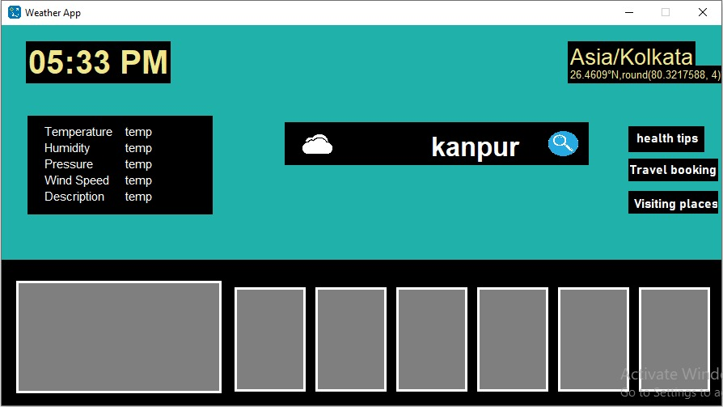
How to use
Step1: Type city or country name in the search bar
Step2: Click on the search icon and get the results
Search bar
Time
Special features
Detail boxl
Weather for whole weak

